Slide 1
Personal Check Sample with a Checkbook Register

Slide 2
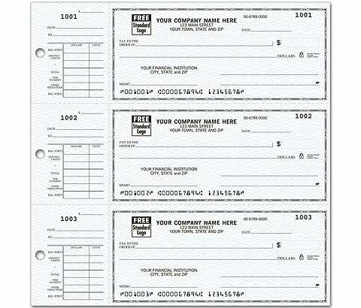
Business Check Sample with Check Stubs

